Slide 1
EMPLOYEE SALARY SLIP GENERATER
PRESENTED BY : 25A31A04D3
25A31A04D4
25A31A04G4
25A31A04G5

Slide 2

INTRODUCTION
Salary slip is an important document for every employee.
It shows the details of earnings, deductions and net salary.
Manual preparation is time consuming and error – prone.
This project automates salary slip generation efficiently.

Slide 3

PROBLEM STATEMENT
Manual salary calculations leads to mistakes.
Difficult to maintain employee salary records.
Time consuming for HR departments.
Lack of Quick access to salary details.

Slide 4

OBJECTIVE OF THE PROJECT
To Generate employees salary slips automatically.
To reduce manual efforts and calculation errors.
To maintain accurate employees salary records.
To provide Quick and reliable salary information.

Slide 5
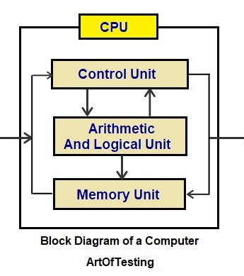
SYSTEM OVERVIEW
Accepts employee details and salary inputs.
Calculates allowances and deductions.
Generates a formatted salary slip.
Displays or prints the final salary slip.

Slide 6
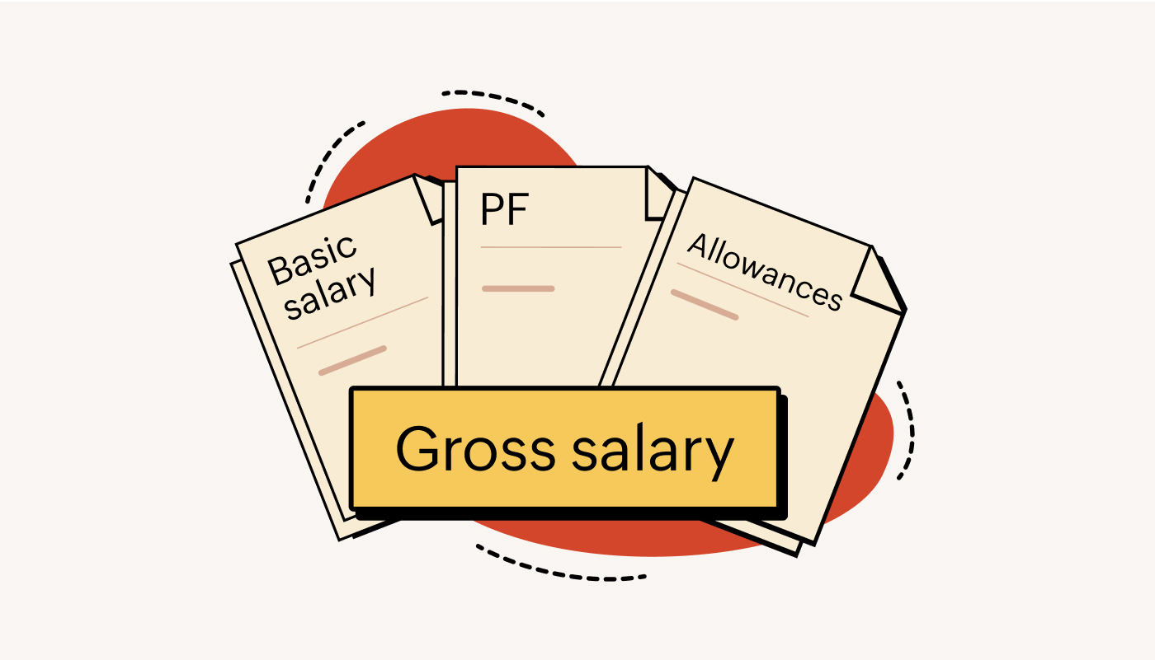
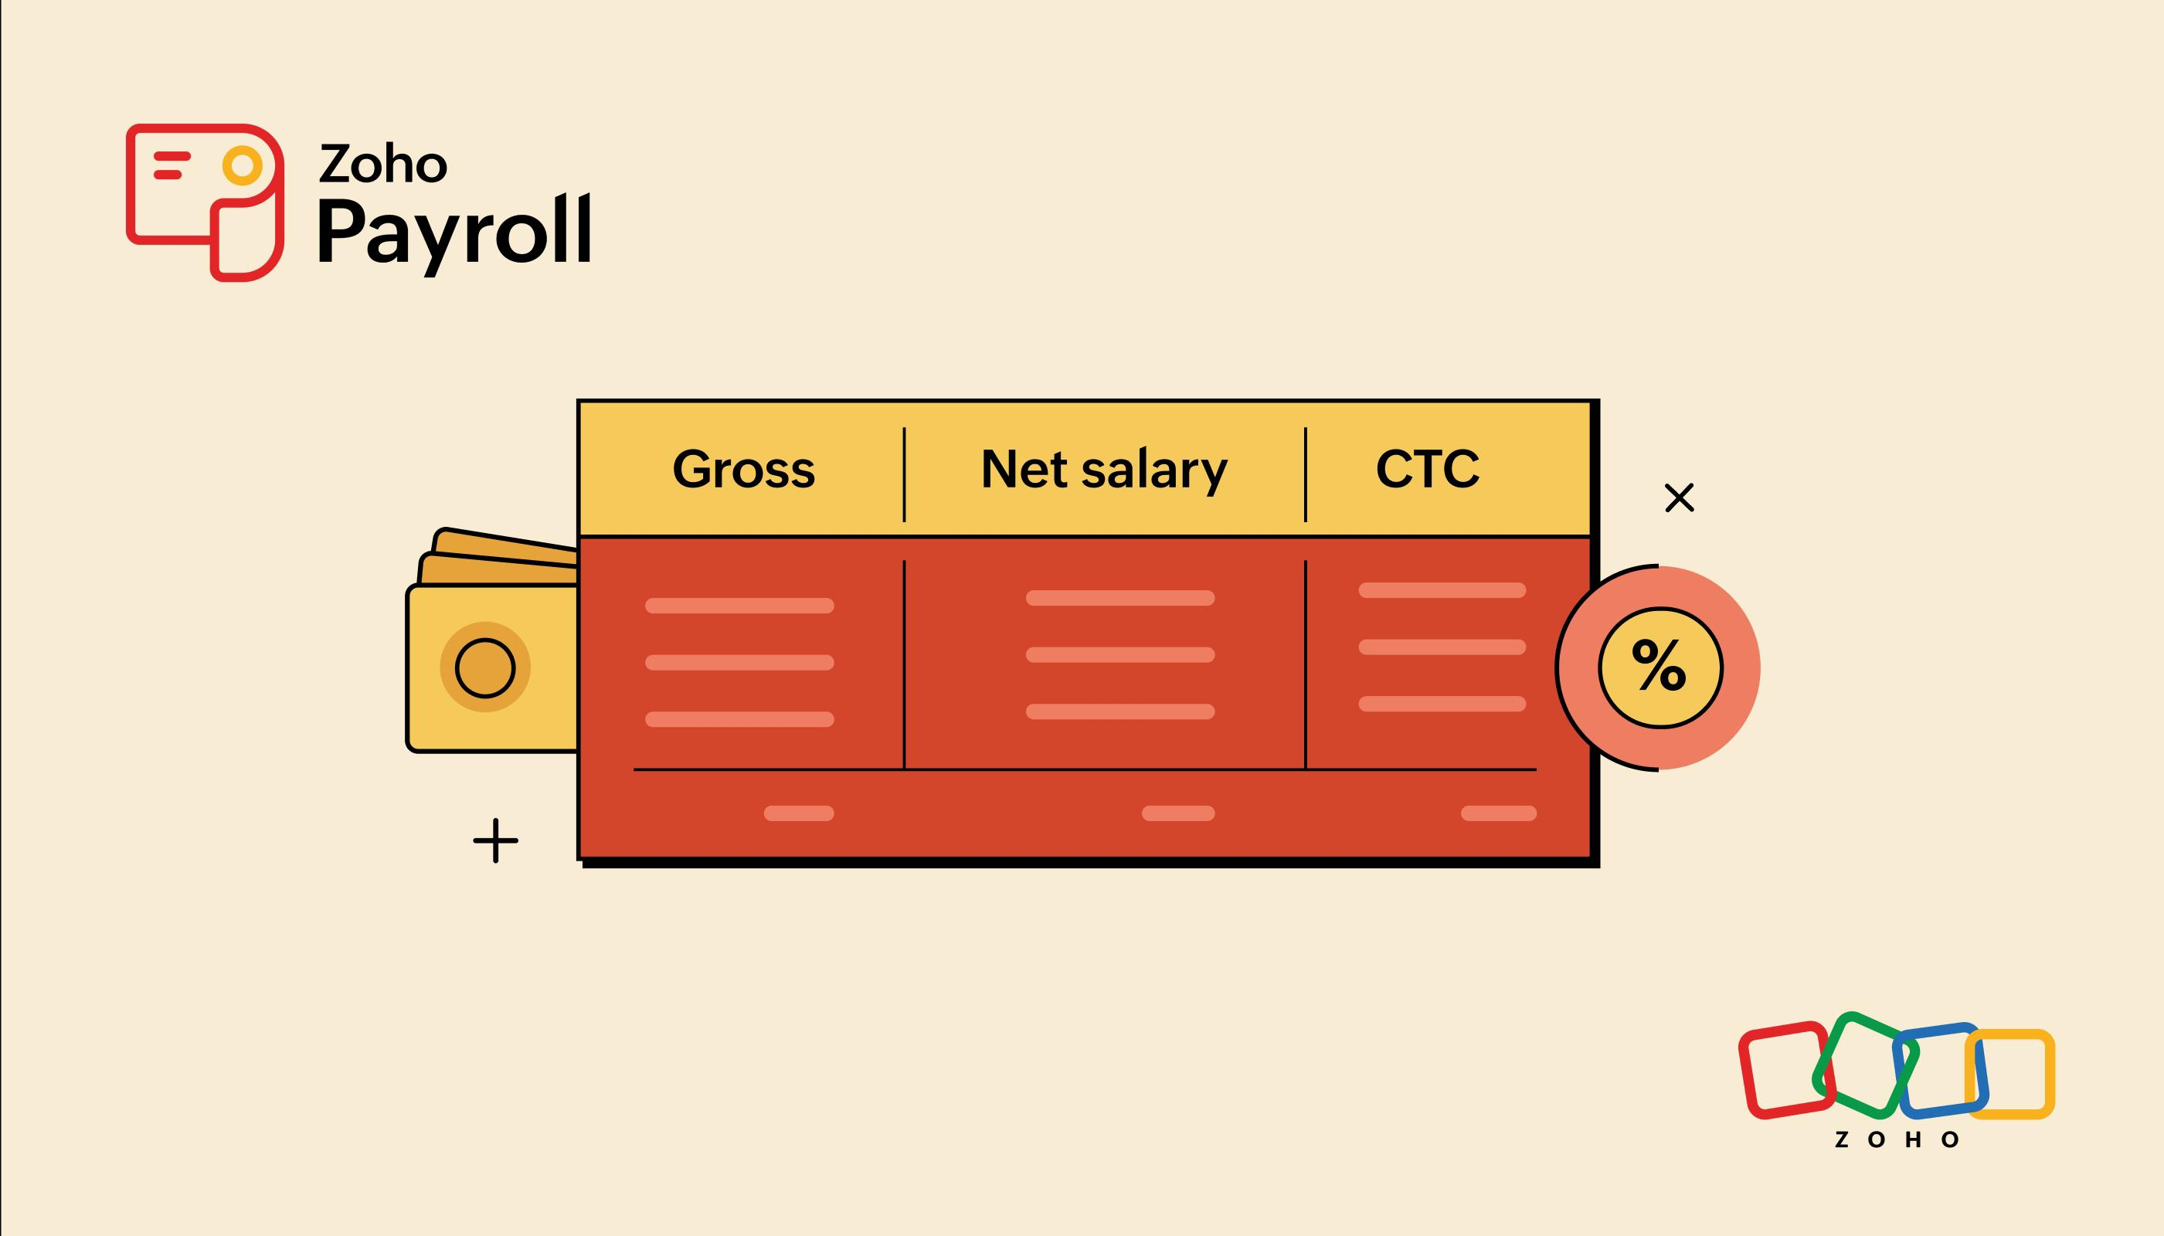
SALARY COMPONENTS
EARNINGS:
Basic salary
HRA
Allowances
DEDUCTIONS:
PF
Tax
Other deductions

Slide 7
FUTURE ENHANCEMENTS
Employees self - service logins .
Email salary slips.
Integration With payroll systems.
Tax report Generations.

Slide 8

Technology stack
FRONTEND: BACKEND:
HTML Java
CSS Python
JavaScript Django

Slide 9
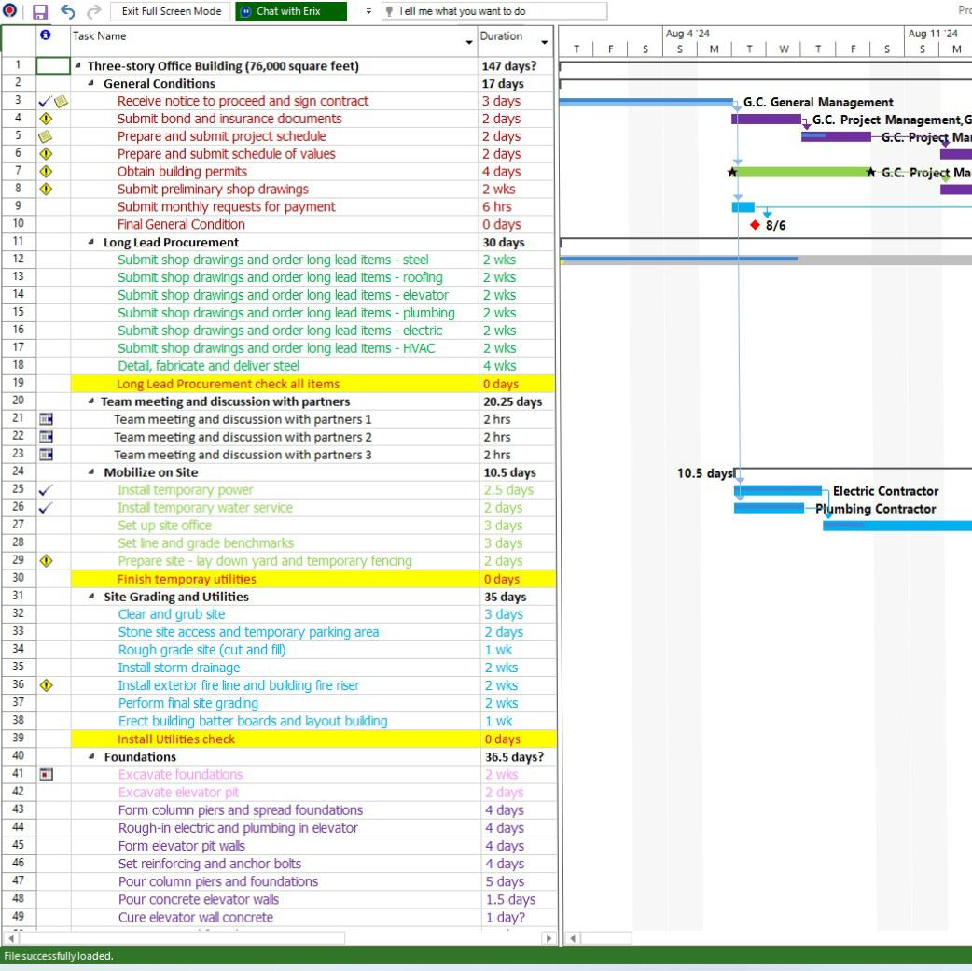
CONCLUSION
The Employee Salary Slip Generator is a vital tool that modernizes and simplifies payroll management for organizations of all sizes. By automating the calculation of earnings, deductions, taxes, and net salary, it minimizes manual effort and reduces errors between employees.

Slide 10

Presented by:
25A31A04D3 – Hasini
25A31A04D4 – Gowri
25A31A04G4- Krishna
25A31A04G5- Samuel

